Slide 1

Visión por Computador
Domingo Mery
Departamento de Ciencia de la Computación
Escuela de Ingeniería
Universidad Católica de Chile
Anomaly Detection

Slide 2
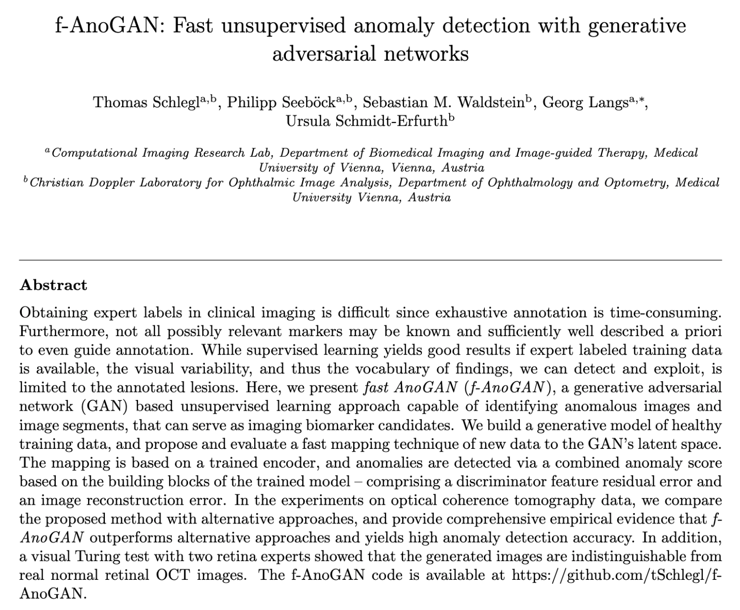

Slide 3
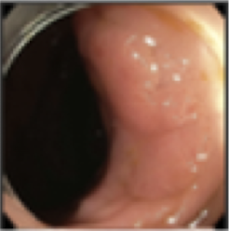
Anomaly Detection – Problem
> Detect an anomaly in an image
Anomaly
Detection
Input: image
Output: Detection

Slide 4

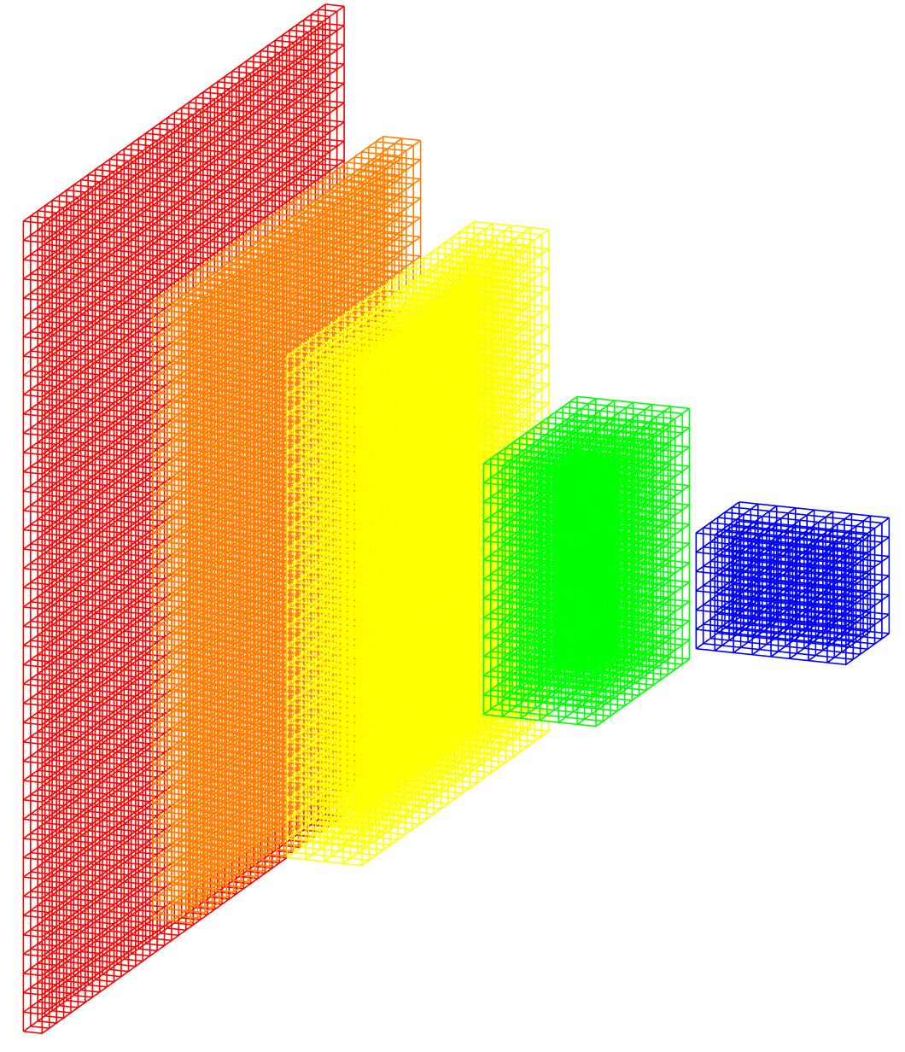
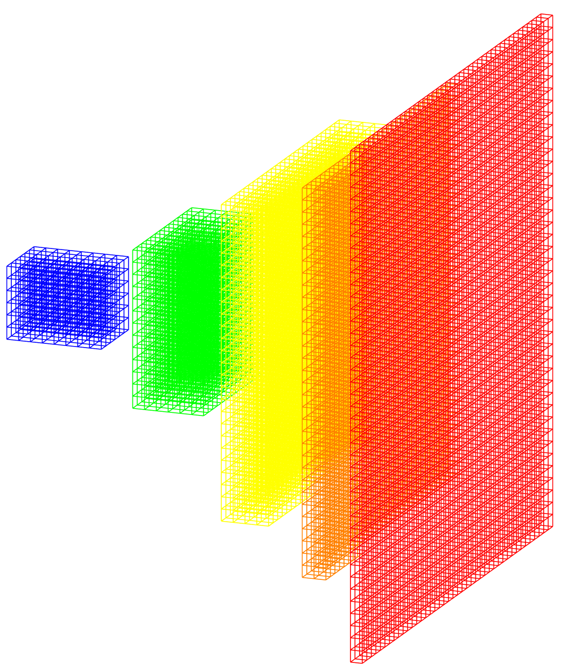
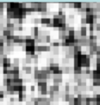
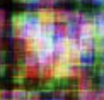
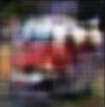
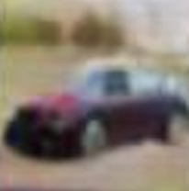
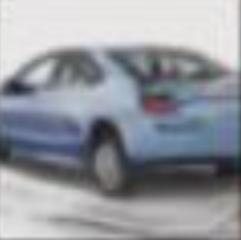
Anomaly Detection – Solution
Deep Learning Model: GAN
Generative Adversarial Network
Ground truth: real/fake
Real image
Discriminator
real/fake
Generator
error
Noise
Fake image
Iter = 1 500 10,000 50,000
error
Notes:
Zero-sum game theory

Slide 5
Anomaly Detection – Solution
Deep Learning Model: GAN
Generative Adversarial Network
Ground truth: real/fake
Real image
Discriminator
real/fake
Generator
error
Noise
Fake image
Iter = 1 500 10,000 50,000
error
Notes:
Zero-sum game theory

Slide 6
Anomaly Detection – Solution
Deep Learning Model: GAN
Generative Adversarial Network
Ground truth: real/fake
Real image
Discriminator
real/fake
Generator
error
Noise
Fake image
Iter = 1 500 10,000 50,000
error
Notes:
Zero-sum game theory

Slide 7
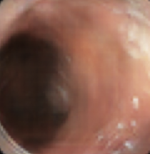
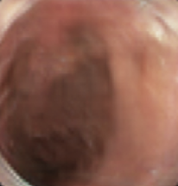
Anomaly Detection – Solution
Deep Learning Model: GAN
Generative Adversarial Network
Images without
anomalies
Ground truth: real/fake
Real image
Discriminator
real/fake
Generator
error
Noise
Fake image
error
Notes:
Zero-sum game theory

Slide 8
Anomaly Detection – Solution
Deep Learning Model: GAN
Generative Adversarial Network
Images without
anomalies
Ground truth: real/fake
Real image
Discriminator
real/fake
Generator
error
Noise
Fake image
error
Notes:
Zero-sum game theory

Slide 9

Anomaly Detection – Solution
Deep Learning Model: GAN
Generative Adversarial Network
Images without
anomalies
Encoder
Generator
Notes:
Zero-sum game theory

Slide 10
Anomaly Detection – Solution
Deep Learning Model: GAN
Generative Adversarial Network
Images without
anomalies
Encoder
Generator
error
Notes:
Zero-sum game theory

Slide 11
Anomaly Detection – Solution
Deep Learning Model: GAN
Generative Adversarial Network
Real Image
with anomaly
Encoder
Generator
Synthetic image
without anomaly
Anomalies
Notes:
Zero-sum game theory

Slide 12
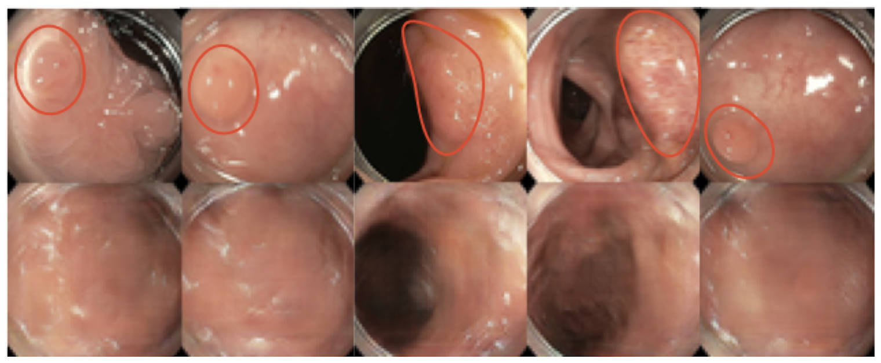
Anomaly Detection – Example
Colonoscopy video frames
Liu, Yuyuan, et al. "Photoshopping colonoscopy video frames." 2020 IEEE 17th International Symposium on Biomedical Imaging (ISBI). IEEE, 2020.

Slide 13
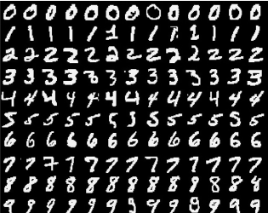
Anomaly Detection – Example
NORMAL
ANOMALY
Notes:
Zero-sum game theory

Slide 14
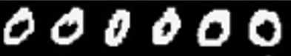
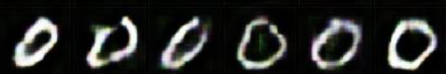
Anomaly Detection – Solution
Images without
anomalies
Ground truth: real/fake
Real images
Discriminator
real/fake
Generator
error
Noise
Fake image
error
Notes:
Zero-sum game theory

Slide 15
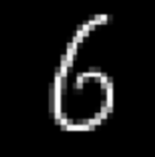

Anomaly Detection – Solution
Real Image
with anomaly
Encoder
Generator
Synthetic image
without anomaly
Anomalies
Notes:
Zero-sum game theory

Slide 16
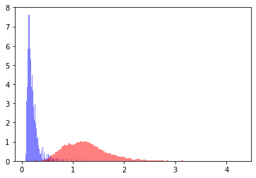
Anomaly Detection – Results 0 vs. the rest

Slide 17
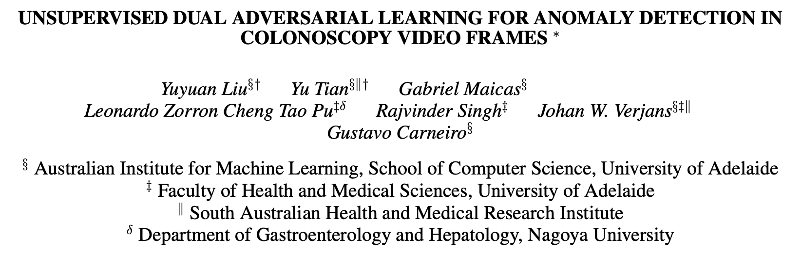
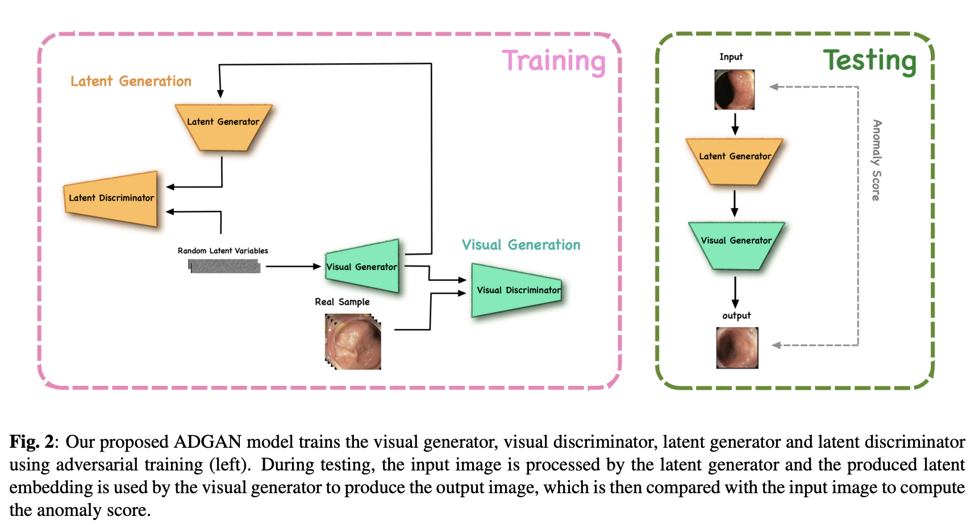

Slide 18
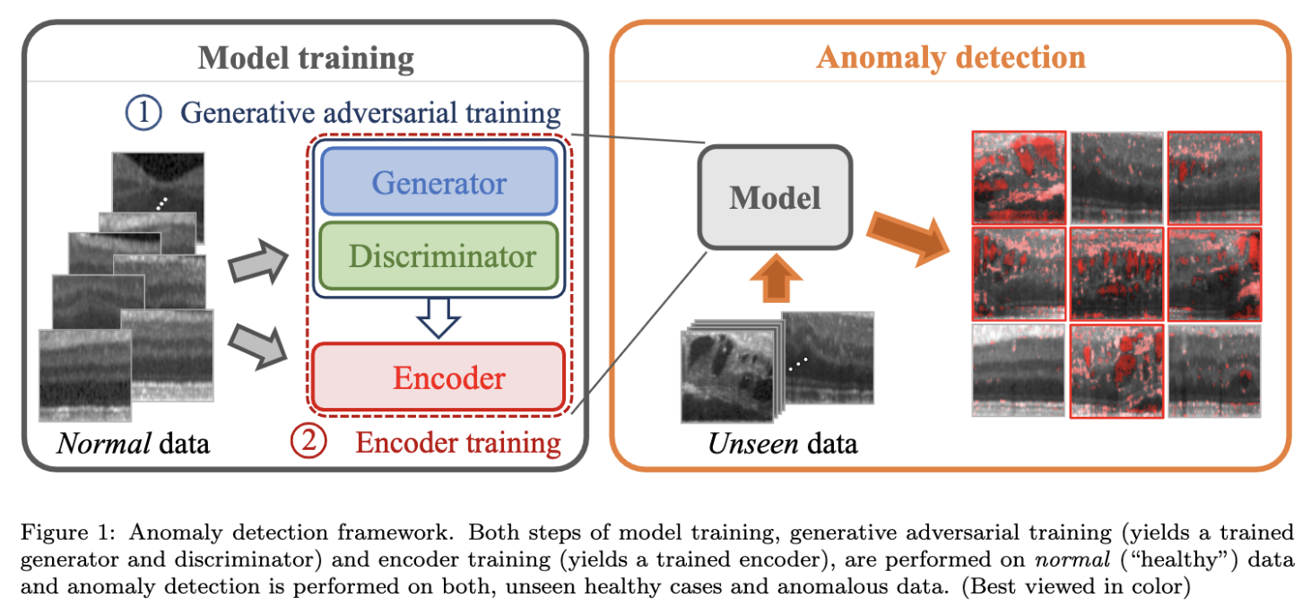

Slide 19
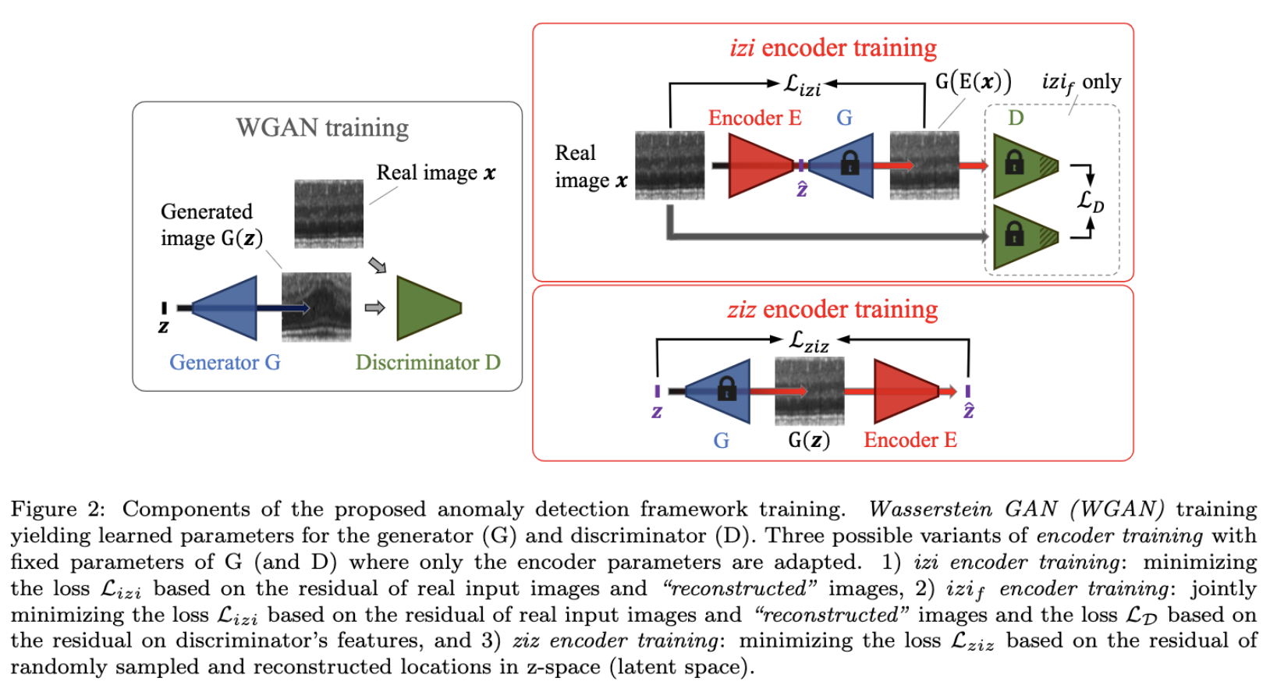

Slide 20
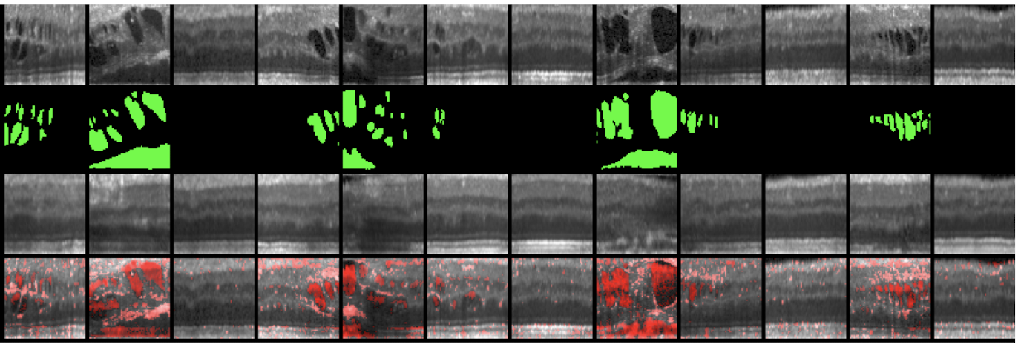
Anomaly Detection – Example
Retinal OCT images
Schlegl, Thomas, et al. "f-AnoGAN: Fast unsupervised anomaly detection with generative adversarial networks." Medical image analysis 54 (2019): 30-44.

Slide 21
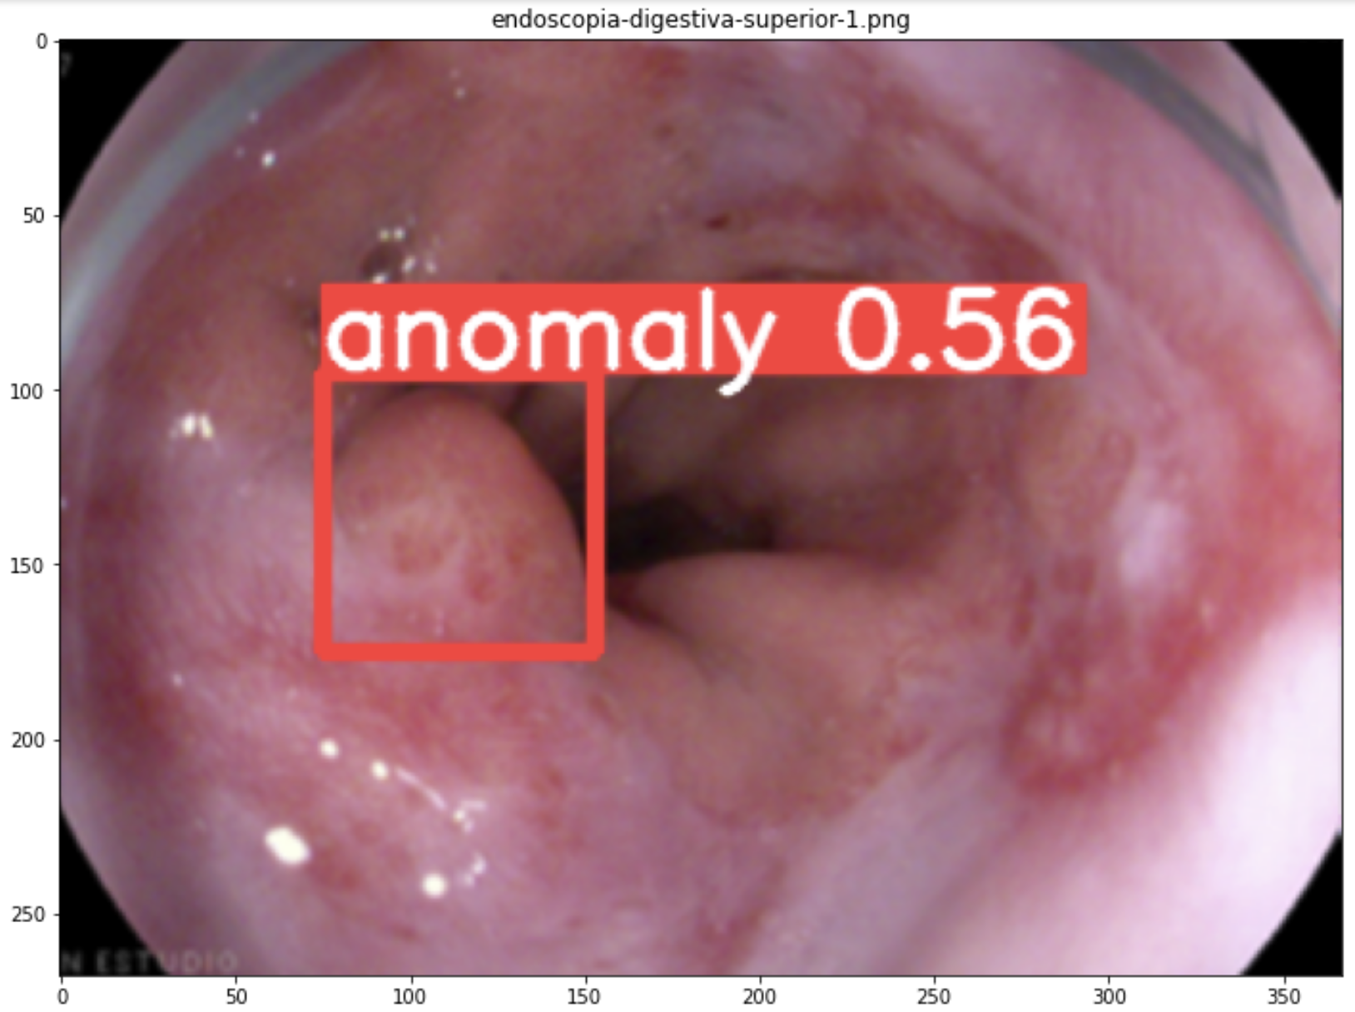
Anomaly Detection – Bonus Track
YOLOv5
Créditos:
Javier Tramon

